Slide 1
Allgemein
  The IO module can be parameterized via the startup list in the bus coupler.
  The 1st IO module starts with index 0x8000, the 2nd with 0x8010 and so on...
  For each IO module there are predefined indices that cannot be changed (shown in gray color).
  If it is necessary to change indices of an IO module (e.g. voltage range of the analog output), entries in the list must be added manually according to the documentation (shown in black color).

Slide 2
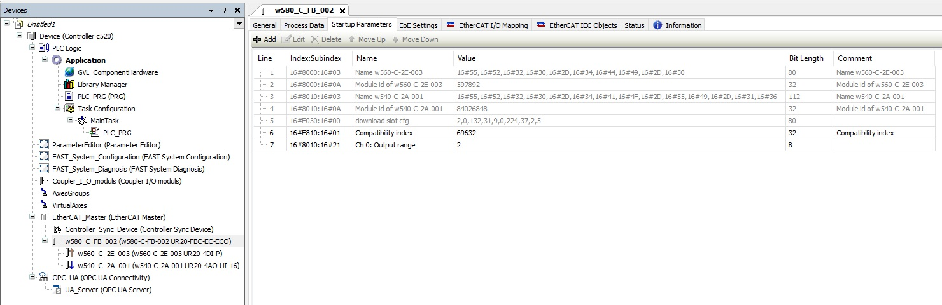
Vorher
Manually created for w540_C_2A_001
Automatically created for w560_C_2E_003
Automatically created for w540_C_2A_001

Slide 3
Änderung
  If an IO module has to be added subsequently and it is not added as the last IO slice, the indices of the automatically created entries are automatically adjusted to the new structure of the IO slices.
  The manually created indexes for the IO modules to the right of the added module must be changed manually, otherwise these modules will be parameterized with incorrect values or indexes cannot be written because they do not exist in this IO module.

Slide 4
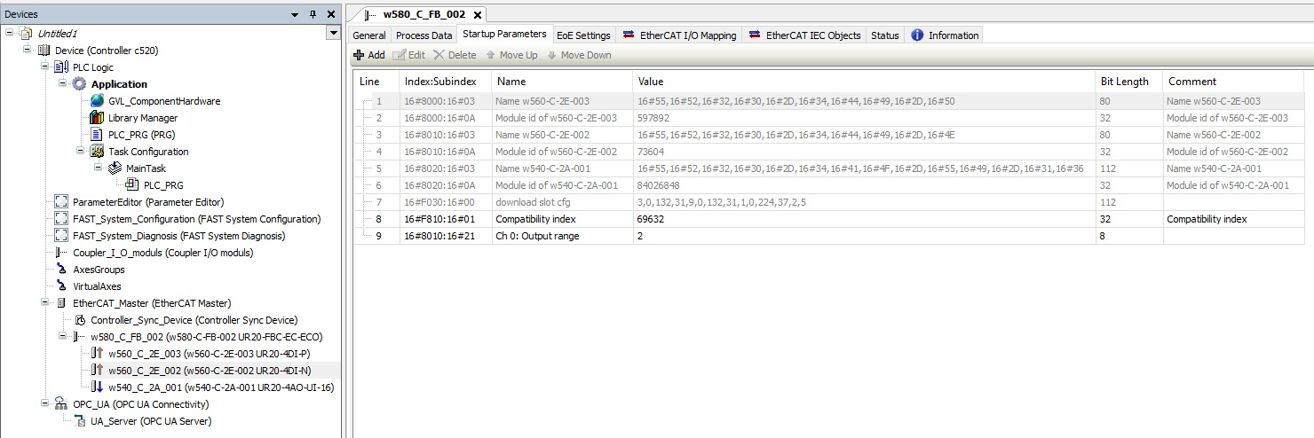
Nachher
Must be changed/moved manually at w540_C_2A_001 (here to 0x8020:16#21)
Unchanged because before the change
Automatically created for new w540_C_2E_002
Automatically changed/
moved for w540_C_2A_001

